Slide 1

PROJECTS TOPIC: STOCK MARKET DASHBOARD
Group name:
GANGS OF DATA ANALYST

Slide 2



Who we are GROUP MEMBERS ARE
Name: Anika Tabssum
Position: Team Lead Dev.
Duties: Documents all ideas
and requirements.
Writes codes and
tester and worked on presentation
Name: Ciaran Walsh
Position: Lead Dev. & Analyst
Duties: Writes codes to specified requirements. Analyzes data & graphs for actionable insights.
Name: Fidelis Omosun
Position: Project Manager
Duties: Coordinate the projects, writes codes and check to make sure all teams members complete their task on time.

Slide 3
Project core message
Creating a stock market dashboard from a Realtime API (iexcloud) that allows investors/user to track daily, weekly and monthly performance of stocks.
Our goal is to be able to give user/investor the ability to select and view stock trends, Analyze relative performance (% change) in stocks over the day, ability to take a snapshot/picture of the chart with a button and also give them options to register on our platform to receive stock trend email update.

Slide 4
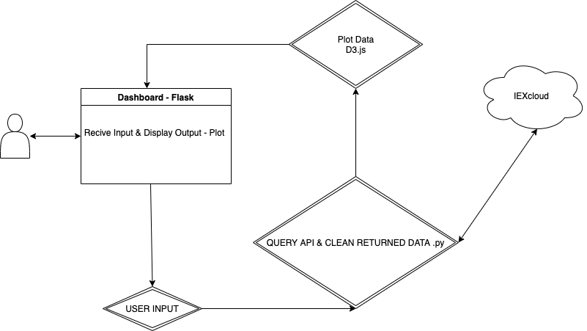
Flowchart Diagram

Slide 5
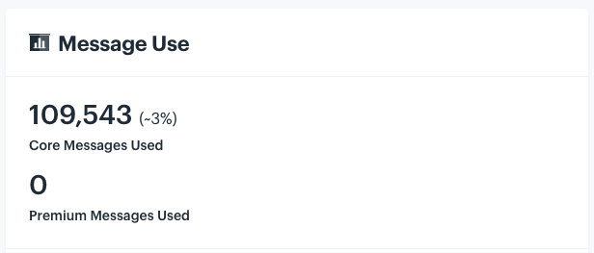
Data source
OUR DATA SOURCE IS FROM IEXCLOUD (https://iexcloud.io/)
IEXCLOUD provides RESTful API for Stock Data
In development we about 110,000 response

Slide 6
Technologies used for this project
Python: High level programming language
IEXfinance – Python Library used to build API queries.
D3.js – Generated scaled candle stick charts to that plot Open, High, Low, Close for each data point.
Flask – Framework used to deploy to web and send user inputs to .PY script. Query API then generate chart as an output. Stock charting & Comparison Dashboard
Others are HTML/CSS, Javascript and Bootscrap

Slide 7
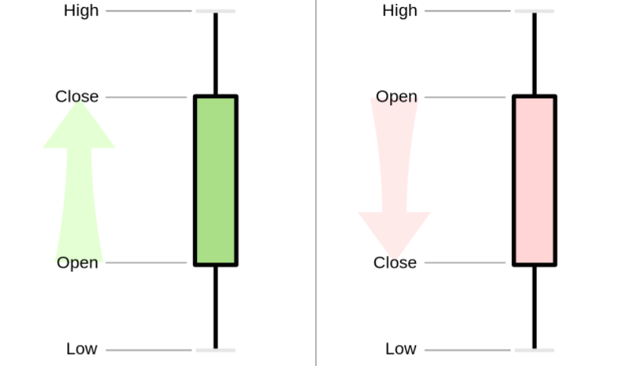
Forex Candlestick patterns

